Slide 1
How to build Highly Available and Scalable Cloud solutions on Azure, what to do and what to avoid!
William Eastbury
Technical Evangelist

Slide 2
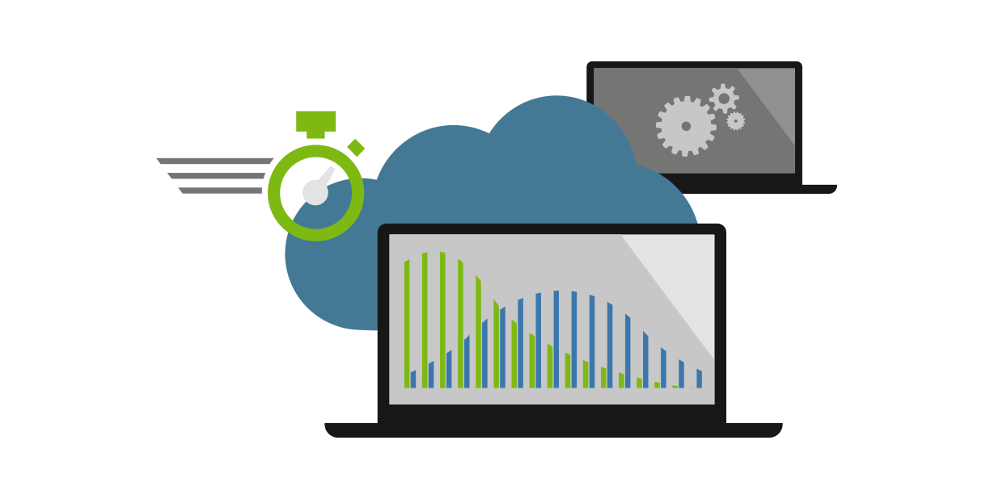
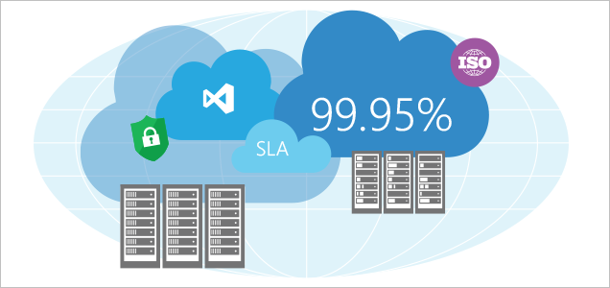
{Introduction and Housekeeping}
Notes:
Welcome to the first of our UK sessions on Azure Best Practices.
Hopefully there will be many more, covering different topics throughout the year and into 2017 …
But first the duty housekeeping…
The Fire Exit path is here, and if there is an alarm test today, that will be clearly indicated in the announced message.
The toilets are back behind the main lifts through reception.
Breaks will be called out, and this afternoon you will be called for the various office hours sessions that we have arranged for you and these are scattered throughout this floor.
If you don’t have an office hours session then you’re stuck with me and Christian for the day as your hosts,
But we have a packed agenda so let’s go!

Slide 3

Speaker
Will Eastbury
Technical Evangelist – ISV / Azure
Microsoft UK - Developer Experience
Notes:
I am Will Eastbury
<will> and jointly we are going to show you some demos along the way of typical cloud patterns and how to implement them on the Azure Platform.
We also have a panel of TE’s available on hand to answer any ‘tricky’ specialist questions !!!

Slide 4

Agenda
Introduction and Housekeeping
Main Theatre Session:
What to do (Cloud Design Patterns and good practices)
What to avoid (Classic errors and mistakes)
Q&A
Lunch
Afternoon - Multiple Tracks
Interactive Chalk ’n’ Talk Group Discussion
Office Hours

Slide 5
The Question.
How do ISV’s build very highly scalable and highly available cloud solutions that can perform with confidence on the Azure cloud, even under extreme loads?

Slide 6
https://aka.ms/AzureEvent
Code: 310102
Todays interaction site …
Please note down questions and post them on the Q&A site, we will use them to drive the content of the interactive group discussion later.

Slide 7
Poll Everywhere
Let’s see how you all score ☺
http://pollev.com/ukdx

Slide 8
Morning: 2 subjects, with 5 key areas
{“Scalability and Performance”}
{“Resilience, Availability
and Disaster Recovery”}

Slide 9
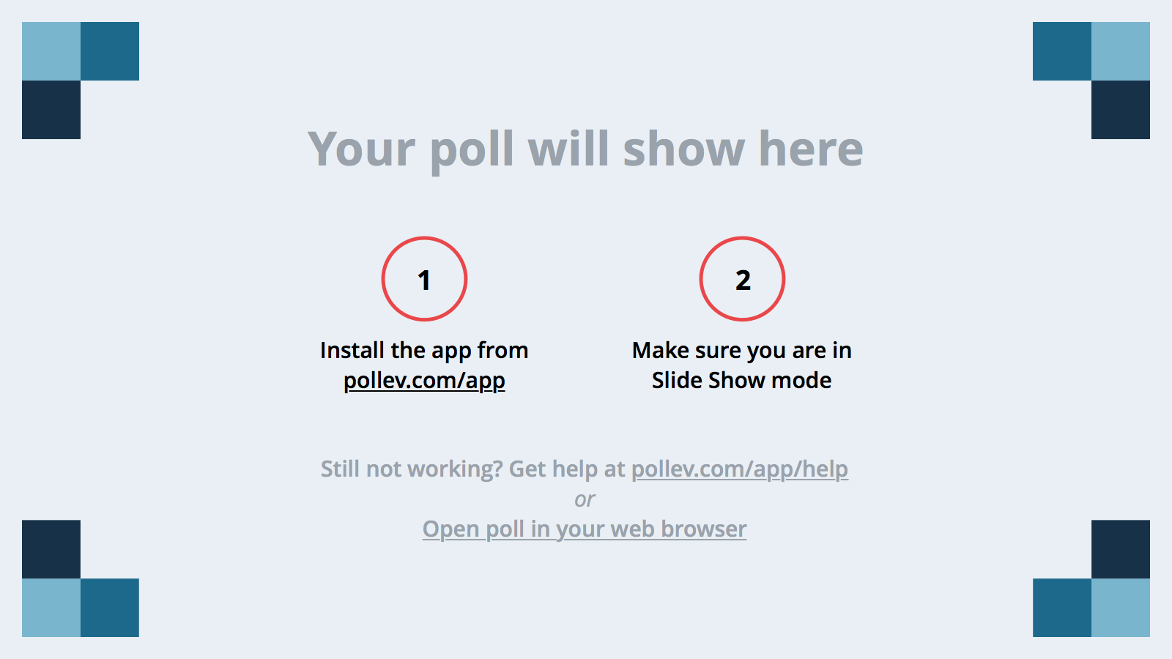
Notes:
Poll Title: Can you see this poll :) https://www.polleverywhere.com/free_text_polls/ga2ZDtcTA44vuCV

Slide 10
{Scalability and Performance} Ensuring your service runs optimally
Notes:
How do I know that my service will perform to an acceptable level under a given load of users and can scale past that level when required?

Slide 11
Scalability – What to do?

Slide 12
Do: Scalability and Performance
Scale out, not up, and use services that spin up super-quickly, like Azure App Service, Webjobs and Functions.
Consider that stateless services are easier to scale out, if your service MUST be stateful - then externalise state to a distributed cache (Redis) where necessary.
Consider patterns such as Queue Based Load Leveling, Competing Consumers and CQRS, we will discuss these in a moment.
When the data layer itself is a hard bottleneck, such as consider sharding the Data Tier or using a data platform that supports partitioning natively (i.e. Azure Table Storage with ‘sensible’ partition and row keys as per).
https://msdn.microsoft.com/en-us/library/azure/hh508997.aspx

Slide 13
DO: Understand Azure Storage Service Throttling
Azure Storage has a built in service DDOS management protection, if requests are above a certain threshold, then throttling automatically kicks in.
These limits apply to IaaS and PaaS Storage :
Max Per-IaaS VHD IOPS (Basic VM:200, Standard VM:500)
Max Per-Storage Account IOPS (20,000)
As a result, only 40 Standard VHDS per storage account can be maxed out on I/O before throttling occurs – don’t share storage accounts between lots of VMs.
Use Windows Storage Spaces to Stripe Data across volumes
Use Premium Storage for Dedicated allocation of IOPS per VM
https://azure.microsoft.com/en-us/documentation/articles/storage-scalability-targets/

Slide 14
Notes:
Poll Title: How does your application use Azure Storage, for VM's or PaaS? https://www.polleverywhere.com/multiple_choice_polls/xdLxJJULbJTuXWN

Slide 15
Notes:
Poll Title: How do you deal with High I/O Workloads ? https://www.polleverywhere.com/multiple_choice_polls/aspKp2bFprsDfBF

Slide 16
Do: Load test your application before deployment
At the absolute least, ensure that some kind of automated load testing is performed to detect a noticeable change in performance of specific, critical endpoints.
Test the application at significant load to ensure that spikes in user activity and load will not take down the application at burst times.
Test your application automatically before deployment using CI / CD Practices, the earlier you find these problems, the cheaper they are to fix.
Notes:
Show of hands for the audience…. All hands in the air.

Slide 17
Notes:
Poll Title: How often do you load test your application? https://www.polleverywhere.com/multiple_choice_polls/f6q8yEm5Ndzlc60

Slide 18
Scalability – What to avoid?

Slide 19
Don’ts: Scalability
Ignore your scalability approach
Some customers believed that the Azure platform automatically handled scaling across all Azure services, without any configuration. This is not true. This is an important concept, which customers must be aware of. For example, Web Apps require scalability rules to be configured, as do VM Scale Sets.
Ignore downtime for scale UP
A number of customers had Single Points of Failure, due to having single instances of certain resources. As such, if they wanted to scale up/out, there could potentially be some down time.
Customers should be aware of the requirements to meet Azure SLAs (particularly for VMs), and also how the platform scales services in use.
Share app service staging slots
Some customers have planned to host their separate environments on the same Web Application, but across different staging slots. All slots run on the same machine, so any strain on load would effect all environments.
Customers should ensure that the environments are appropriately separated, so that load in one environment, does not negatively impact another.
Notes:
https://azure.microsoft.com/en-gb/documentation/articles/best-practices-scalability-checklist/
https://azure.microsoft.com/en-gb/documentation/articles/best-practices-data-partitioning/
https://azure.microsoft.com/en-gb/documentation/articles/storage-concurrency/

Slide 20
Notes:
Poll Title: How do you scale out state in your application? https://www.polleverywhere.com/multiple_choice_polls/4vzPoPtPHkBoROo

Slide 21
Don’ts: Performance
Ignore caching / or use excessive caching
Many customers caching approach is not appropriate for their solution. This is true across various levels (e.g. Caching of data via Redis cache, through to caching of assets via CDN).
Customers should consider their SLAs (in terms of service requirements), and understand how caching can improve performance compared to adding additional complexity and cache lifecycle headaches.
lack of design for latency
Highly variable latency is normal for access to internet based services as are random timeouts and transient errors as services auto-scale and auto-recover.
When operating services in the cloud, latency constraints usually need to be relaxed and there needs to be an acceptance that some operations will timeout and need to be retried automatically.
Notes:
https://azure.microsoft.com/en-gb/documentation/articles/best-practices-scalability-checklist/
https://azure.microsoft.com/en-gb/documentation/articles/best-practices-caching/
https://azure.microsoft.com/en-gb/documentation/articles/storage-scalability-targets/

Slide 22
Notes:
Poll Title: Application Design - Check the following that are true https://www.polleverywhere.com/multiple_choice_polls/ZICWzErS9Ing02h

Slide 23
App Service Specific optimisations
Disable Session Affinity Cookie
Enable AlwaysOn
Enable Auto-Scaling
https://azure.microsoft.com/en-us/blog/disabling-arrs-instance-affinity-in-windows-azure-web-sites/
Notes:
If you don’t need web affinity, turn it off, this will mean being routed to a node more quickly, and a more even load balancing across your services.
If your site traffic is sporadic, you would probably want to keep the site spun-up and in memory : for an instantaneous response discuss Always On
Auto-Scaling is a given
Scale up: Get more CPU, memory, disk space, and extra features like dedicated virtual machines (VMs), custom domains and certificates, staging slots, autoscaling, and more. You scale up by changing the pricing tier of the App Service plan that your app belongs to.
Scale out: Increase the number of VM instances that run your app. You can scale out to as many as 20 instances, depending on your pricing tier
The scale settings take only seconds to apply and affect all apps in your App Service plan. They do not require you to change your code or redeploy your application.

Slide 24
Notes:
Poll Title: App Service - Select the features that you use. https://www.polleverywhere.com/multiple_choice_polls/VXA9PXTpfdVL4GG

Slide 25
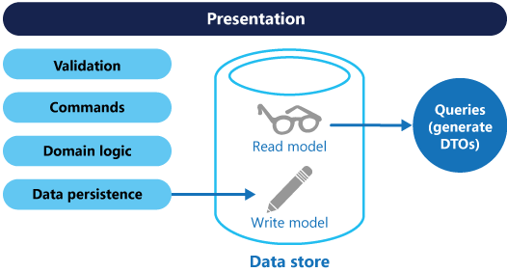
Command and Query Responsibility Separation Pattern
https://aka.ms/CQRS-Pattern
Notes:
CQRS – Initially have read and write through the same channel and schema and hosting layer.
Classic REST CRUD API (Hammering R, with Intermediate C’s)
When service is overloaded with R’s the whole service dies.
Split CU into another ‘Upsert’ Function , and breakout R into another read function (LINQ Iqueryable).
Update load test,
this is how the app has already been designed, show the split of nano-services in the function app.
Comment that with this design we could break out each individual nano-service onto its own server farm if we needed to !!!

Slide 26
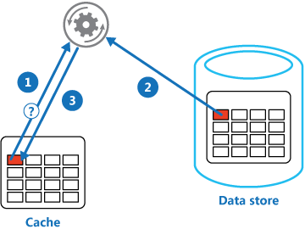
Cache-Aside Pattern
https://aka.ms/cache-aside-pattern
Notes:
Consider the Cache-Aside pattern on READS
All very well and good at this point but how to we speed up reads from a database where the same query is requested often
Determine if the item is in the cache
If not load it from the store
Store the item in the cache
Return the item
// Distributed Caches vs In memory Caches – Network Overhead vs. Memory Consumption
// Redis Cache Service

Slide 27
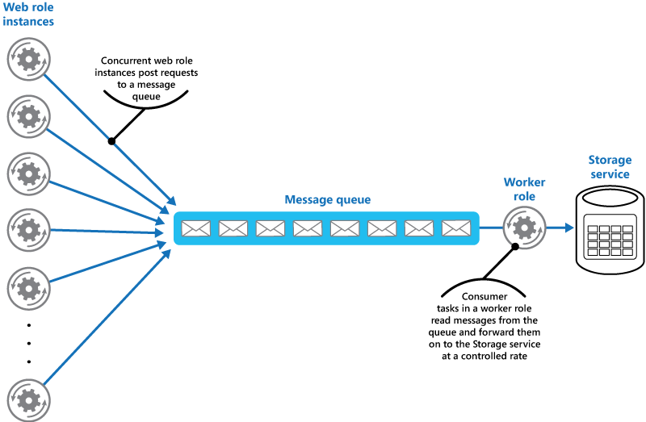
Queue Based Load Leveling Pattern
https://aka.ms/queue-based-load-leveling-pattern
Notes:
Push Inserts through Queue with a single consumer.
// Talk about
Asynchronous, so return a 202 – Accepted http message, not a 200 – Success message
CAN Expose a query function url separately for the result (blob endpoint)
Eventually bottleneck will be 24 hr operation of a maximum sized queue consumer.

Slide 28
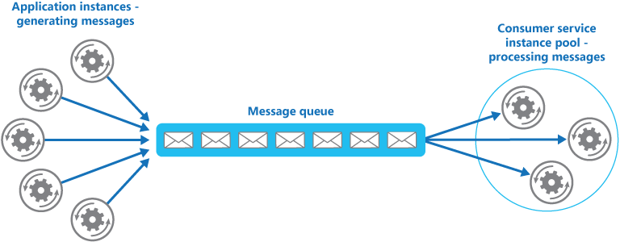
Competing Consumers Pattern
https://aka.ms/competing-consumers-pattern
Notes:
Scaling out: when our queue consumer becomes a bottleneck, simply run more instances of the consumer.
If the receiver data layer service is a bottleneck, look to the Sharding pattern to split load across multiple dbs or storage accounts.
This is already implemented for us for free as we are using functions, if we simply choose a hosting plan with multiple cores or instances then webjobs / functions will run it flat out.
Usually the data tier is hard to scale, not with this design

Slide 29
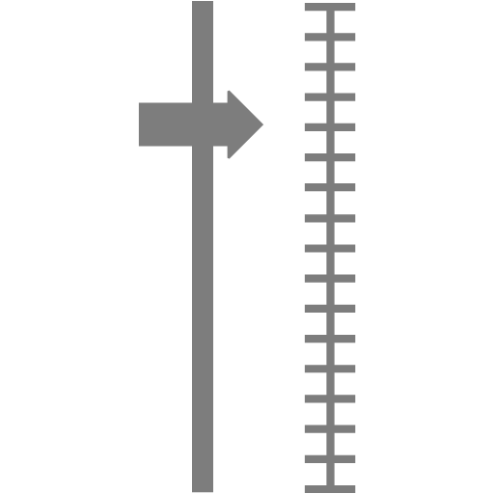
Scale out, not up! (Externalising Service State via a Distributed Cache, rather than Sticky Sessions)
https://azure.microsoft.com/en-us/documentation/articles/cache-aspnet-session-state-provider/
Notes:
Redis Cache Pre-spun up
Asp.net classic web forms app in app service
Voting app – click one of two buttons, EXPOSE SERVER NAME ON GUI SOMEWHERE
Disable session affinity cookie – explain what / why this is… (sticky sessions) if you lose or recycle an instance then your state is gone.
Will be fine with one instance – scale to two instances with slider drag in portal
Count will reset every time you hit a new server.
Implement asp.net session state provider for redis cache, now will have one count shared across multiple instances.
Make it clear we are not talking about locking or distributed processing semantics, but simply use of the providers.

Slide 30
Notes:
Poll Title: Scalability Design Patterns - We implemented the following Cloud Patterns. https://www.polleverywhere.com/multiple_choice_polls/JSjILoXrvN5Rejh

Slide 31
Notes:
Poll Title: How do you scale your service? https://www.polleverywhere.com/multiple_choice_polls/hHhTFcKPkOJR6aO

Slide 32
{Resilience, Availability and Disaster Recovery} How do I best use features of Azure to make sure that my service stays available even in the case of failures?
Notes:
So we can build the most resilient and complex solution on the planet, that survives nuclear attack on multiple continents simultaneously if we need to.
But that solution would be expensive, VERY expensive to run, or would it – let’s look at some patterns and practices that can be used to mitigate the cost of building highly available solutions.
How can you ensure maximum performance and scalability for a commercially reasonable Cost of Service?

Slide 33
Resilience – What to do?

Slide 34

DO: Determine the uptime and NFRs of the solution
What are the Fault Tolerance / Backup +
Recovery objectives?
RTO
RPO
Max Downtime / 9’s
MTBF (Time Between Failures)
MTTR (Recovery Time)
What is the COST OF DOWNTIME?
Availability/resilience/SLAs
Data retention policy
Location / Residency Restrictions
Schema management requirements
Notes:
These are different in the cloud to on-premise, cloud datacentres are architected and built differently.
Talk about MTTR vs MTBF.
In the Cloud something is usually on fire, but systems auto-recover quickly

Slide 35
Notes:
Poll Title: Check all that apply, I understand the following Fault tolerance and Disaster Recovery NFRs of the workload. https://www.polleverywhere.com/multiple_choice_polls/O2ODrUZymTFnLdg

Slide 36
Notes:
Poll Title: Check all that apply, I understand the Cost of downtime NFRs of the workload https://www.polleverywhere.com/multiple_choice_polls/8vNLuIqTVbqEHnu

Slide 37
DO: Understand the inter-dependencies between services inside and outside your solution, if you do not – then document them.
Could you list every component in the solution, along with it’s dependencies and sub-components?
Could you draw a diagram of those components – i.e. your solution architecture on a whiteboard or piece of paper, marking key components ?
Now could you annotate that diagram with performance and resilience data, i.e. Single points of failure and typical performance bottlenecks in day to day usage?
Can you indicate where those components are geographically located on a map and if data is replicated elsewhere, indicate the mirrored region and the methodology of data movement / sync / mirroring etc?
Can you show the entry point into your solution for a customer / end user (there may be multiple entry points) - i.e. which services are considered the 'front' of the stack - do the same on the geo map.
Can you trace a path through the call stack of the application from that front end, stepping through each component used and region where data transits ?

Slide 38
Notes:
Poll Title: Check all that apply, I completely understand the Dependency Graph of my workload. https://www.polleverywhere.com/multiple_choice_polls/fKNbODnSlCc5WJW

Slide 39
Resilience – What to avoid?

Slide 40
Don’ts: Resilience
Single-region deployment in azure
Some customers believe that Azure automatically deals with scalability and resiliency across regions.
Customers should plan for an outage of services in a particular region and failover where necessary
lack of strategy for resilience within services
Some Azure Services have functionality built in, to deal with availability.
Customers should be aware of these services, e.g. Traffic Manager, or Service Bus Paired Namespaces, Storage GRS vs RA-GRS (and failover)
Ignore third party dependencies that could kill your service
Most solutions have included dependencies outside of Azure.
Customers should ensure that a graceful degradation occurs, for components inside Azure and outside.
ignore single points of failure
Some solutions we have seen have single points of failure in their solution. If this goes down, your application will be down.
Customers should run all tiers of their application in a resilient manner if the SLA requires it.
Notes:
https://azure.microsoft.com/en-gb/documentation/articles/storage-redundancy/
https://azure.microsoft.com/en-gb/documentation/articles/resiliency-technical-guidance/
https://azure.microsoft.com/en-gb/documentation/articles/guidance-compute-multi-vm/
Talk a little more about LRS vs GRS vs RA-GRS in storage.

Slide 41
Don’ts: Availability and Disaster Recovery
Ignore a major incident response plan
In a number of assessments, customers did not have a Major Incident response plan in place.
Customers should ensure that they have a MIRP in place, clearly defining responsibilities across the solution, escalation protocol and any other necessary processes to follow in a disastrous scenario.
Ignore the need for a data reconciliation strategy
Many solutions are based around the concept of Eventual Consistency and / or multi-region deployment.
When faced with region failover, how do you know that critical data is present and valid in the new region, what was lost from the primary region and may now never arrive in the secondary ?
Fail to test your dr / ha strategy
A number of customers had either an automated Disaster Recovery mechanism or well-documented approach. However, this approach had not yet been tested.
Customers should test their disaster recovery semi-regularly, to ensure that the process is still relevant and that all parties are aware of the required steps.
Notes:
W: Lack of MIRP
C: Lack of DR Drill
https://azure.microsoft.com/en-gb/documentation/articles/best-practices-availability-checklist/
https://azure.microsoft.com/en-gb/documentation/articles/storage-redundancy/

Slide 42
Notes:
Poll Title: Do you have the following in place for this workload? https://www.polleverywhere.com/multiple_choice_polls/CvRIrql8GY44YmC

Slide 43
Don’ts: Deployment
lack of load testing on release
If a customer introduces a performance bottleneck in code, they will be unaware until it is in users’ hands.
Customer should load test their solution ahead of every major release. This will act as a guideline for any performance defects.
lack of continuous integration
A number of customers did not follow recommended practices around continuous testing and integration.
Customers should employ DevOps practices around continuously integrating their code, to ensure that their developers are working on the latest set. Additionally, the customer can run regular unit / integration tests, to check for regression in code quality.
lack of continuous delivery
A number of customers did not operate a continuous delivery pipeline. This is not essential, but could aid in agility of software delivery.
If desirable, customers should employ DevOps practices around continuously deploying their code. Once a good build is found in Dev/Test, the team can push this through to production, using their typical release process.
Notes:
https://azure.microsoft.com/en-gb/documentation/articles/best-practices-monitoring
https://azure.microsoft.com/en-gb/documentation/articles/guidance-compute-3-tier-vm/
Note, Continuous Delivery, not necessarily Continuous Deployment – explain the difference.

Slide 44
Notes:
Poll Title: Tell us about your deployment process. https://www.polleverywhere.com/multiple_choice_polls/YaAJi6Zy4g0NnWi

Slide 45
Notes:
Poll Title: In your own words, what does your Deployment process look like ? https://www.polleverywhere.com/free_text_polls/wODIC5KCkWhufuH

Slide 46
Resilience – Patterns

Slide 47


Azure Load Balancer and Azure Traffic Manager
Load Balancers
Deploy to Multiple Machines inside a region
Traffic Manager
Geo-Load balance the local load balancers
Deploy to Multiple Regions
Failover between regions
Round-Robin routing to nearest region
A/B Weighted Traffic routing
Notes:
Talk about Single instance SLAs in Azure for IaaS and use of load balanced sets etc.
i.e. None
Talk through traffic manager over the front of two deployments of app-service or VM loadbalancers in different regions.

Slide 48
Caching pages and content AKA CDNs and OR the Static content hosting pattern
Notes:
There are a few versions and subtle differences to this pattern.
- CDN caching of the whole site – works well for relatively static sites
- Output Caching via Redis / files – works well for sites that take a lot of CPU to generate output
Pre-Generated output of the whole site, this works if you are generating really media intensive sites.
Take your pick

Slide 49
Azure Storage – HA and Redundancy
Replication strategy | LRS | ZRS | GRS | RA-GRS
Data is written synchronously to local nodes | Yes | Yes | Yes | Yes
Data is replicated async across multiple facilities. | No | Yes | Yes | Yes
Data can be read from the secondary location as well as from the primary location. | No | No | No | Yes
Number of copies of data maintained on separate nodes. | 3 | 3 | 6 | 6
Premium Storage Available | YES | No | No | No
https://azure.microsoft.com/en-us/documentation/articles/storage-redundancy/
Notes:
Switch in portal. Explain each type of storage and where it is appropriate
Talk about Optimistic concurrency for blobs and containers
The Storage service assigns an identifier to every object stored. This identifier is updated every time an update operation is performed on an object. The identifier is returned to the client as part of an HTTP GET response using the ETag (entity tag) header that is defined within the HTTP protocol.

Slide 50
Notes:
Poll Title: Do you use any of the following services for DR / HA ? https://www.polleverywhere.com/multiple_choice_polls/cA10CO9KJeuBgWC

Slide 51
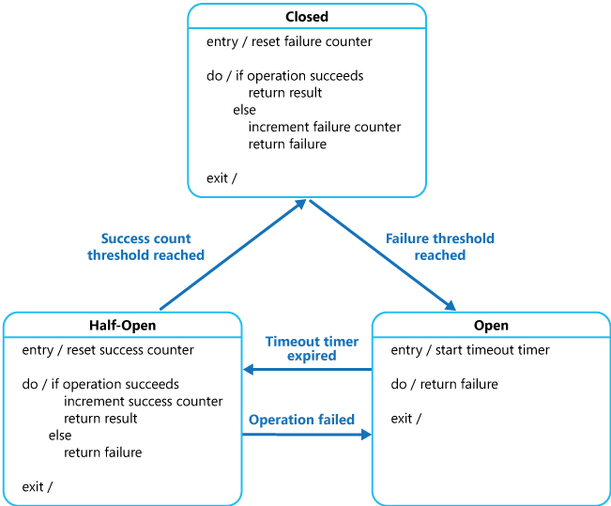
Failover and Circuit Breaker Pattern
https://aka.ms/Circuit-Breaker-Pattern
Notes:
-- Retry logic // on a certain number of failures in asset period you should failover to a known good resource.
-- Make sure that there is a secondary queue / account to demonstrate with
-- Talk to Eventual Consistency Pattern.

Slide 52
Notes:
Poll Title: Resilience and Availability Design Patterns https://www.polleverywhere.com/multiple_choice_polls/77sLRL0aNQ9P97S

Slide 53
Links and Downloads
Free Cloud Design Patterns ebook
http://www.microsoft.com/en-us/download/details.aspx?id=42026
Cloud Design Patterns Poster
https://azure.microsoft.com/en-us/documentation/infographics/cloud-design-patterns/
This session - Demos and Presentation Repository
https://github.com/dxuk/AzureWorkshops/blob/master/BestPractices-1stSept2016/Best%20Practices%20-%20Scalability%2C%20Availability%2C%20Performance%20and%20Resilience.pptx

Slide 54
Notes:
Poll Title: What would you MOST like to talk about this afternoon in the group discussion ? https://www.polleverywhere.com/free_text_polls/d3iPGFwE0Y5r0S3

Slide 55
Q&A
Let’s walk through the App board and answer your questions.

Slide 56
Lunch
Please put any questions up on the post-it board for our Kanban Q&A Session after lunch !

Slide 57
Afternoon Tracks: Chalk and Talk, Office Hours
Group Discussion
This Room (Kew Auditorium)
Chalk and Talks, William Eastbury
Jagger: Office Hours
With Joni Collinge /and David Gristwood
Globe: Office Hours
With Amy Nicholson and Bianca Furtuna

Slide 58
Chalk ‘n’ Talk
Interactive Discussion

Slide 59

Evaluation Forms
We hope you have enjoyed the day, but we have one last ask of you.
Please out your evaluation forms to give us feedback on what we did right and how we can improve the sessions next time.
Your feedback is critical to making more of these sessions a success !

